Slide 1
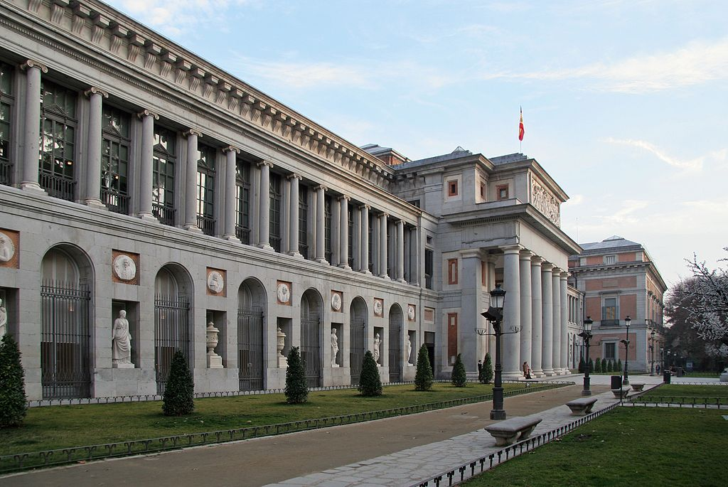
Museo del Prado by Alexandro Velazquez
Hours:
Monday 10:00 am – 8:00 pm
Tuesday 10:00 am – 8:00 pm
Wednesday 10:00 am – 8:00 pm
Thursday 10:00 am – 8:00 pm
Friday 10:00 am – 8:00 pm
Saturday 10:00 am – 8:00 pm
Sunday 10:00 am – 7:00 pm
Paseo del Prado, s/n, 28014 Madrid, Spain

Slide 2
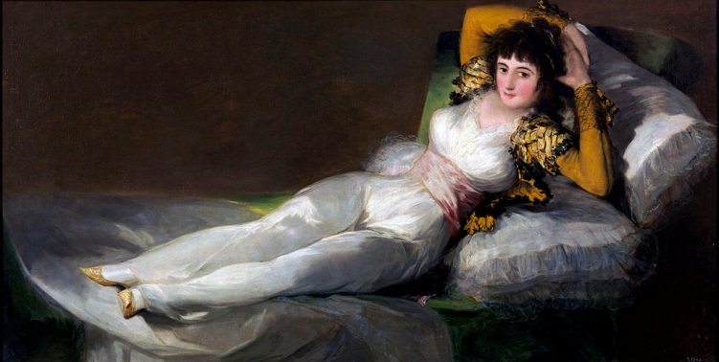
The Clothed Maja
The Clothed Maja is a painting by the Spanish painter Francisco de Goya between 1800 and 1805. The painting was first owned by Prime Minister Manuel de Godoy, who was known as an avid womanizer, and originally hung in his home in front of the Naked Maja in such a manner that the Naked Maja could be revealed at any time with the help of a pulley mechanism

Slide 3
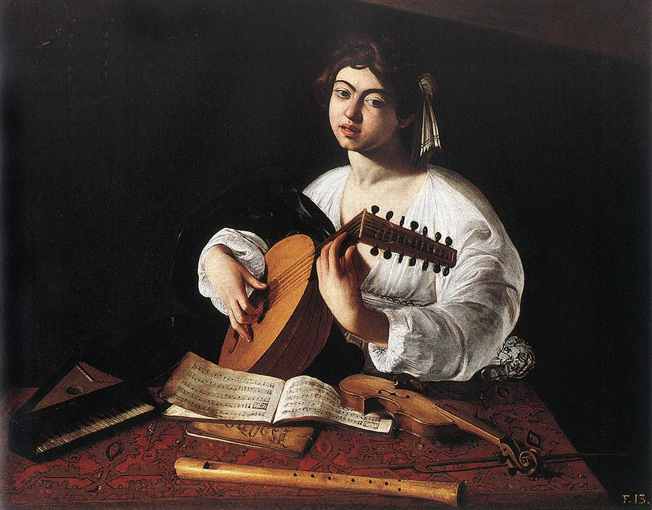
The Lute Player
The Lute Player (1596) is a composition by the Italian Baroque master Caravaggio. It exists in three versions, one in the Wildenstein Collection, another in the Hermitage Museum, St. Petersburg and a third from Badminton House, Gloucestershire, which came to light in 2007.

Slide 4
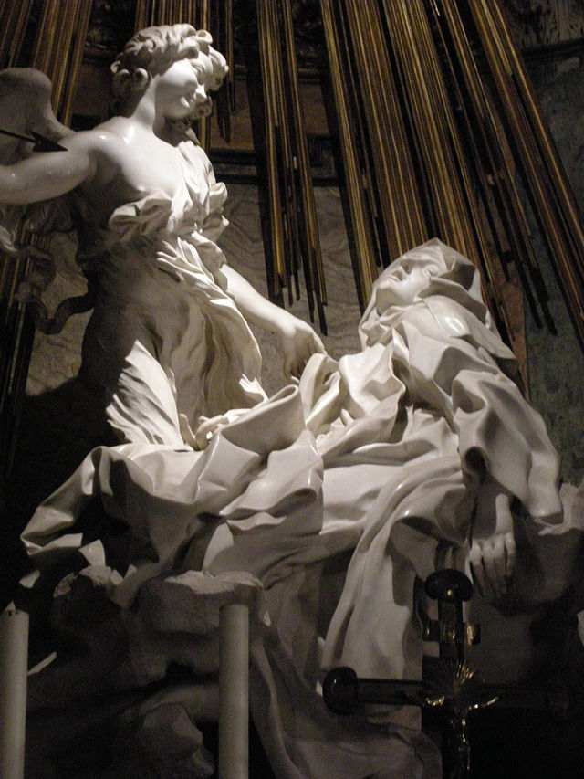
Ecstasy of Saint Teresa
L'Estasi di Santa Teresa or Santa Teresa (1647) is the central sculptural group in white marble set in an elevated aedicule in the Cornaro Chapel, Santa Maria della Vittoria, Rome. It was designed and completed by Gian Lorenzo Bernini, the leading sculptor of his day, who also designed the setting of the Chapel in marble, stucco and paint. It is generally considered to be one of the sculptural masterpieces of the High Roman Baroque. It pictures Teresa of Ávila.

Slide 5
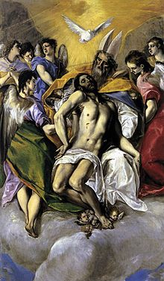
The Holy Trinity
The Holy Trinity (1577–1579) of works created for the church Santo Domingo el Antiguo. The influence of Michelangelo, Durer, or Taddeo Zuccaro is usually evoked with respect to the conception and the composition of this canvas - one of the set painted for the retable of Santo Domingo el Antiguo - as well as to the attitudes and the anatomy of the figures. More impressive and certain than this borrowing, however real and instrumental it may have been, is the impact of El Greco's creative will, which makes this work already so personal and so mature.

Slide 6
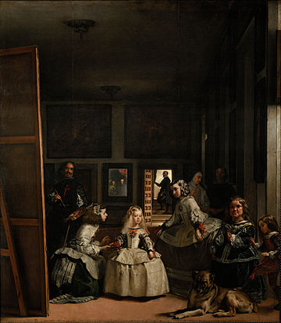
Las Meninas
Las Meninas (Spanish for The Maids of Honour) is a 1656 painting by Diego Velázquez, the leading artist of the Spanish Golden Age, in the Museo del Prado in Madrid. The work's complex and enigmatic composition raises questions about reality and illusion, and creates an uncertain relationship between the viewer and the figures depicted. Because of these complexities, Las Meninas has been one of the most widely analyzed works in Western painting.
The painting shows a large room in the Royal Alcazar of Madrid during the reign of King Philip IV of Spain, and presents several figures, most identifiable from the Spanish court, captured, according to some commentators, in a particular moment as if in a snapshot

Slide 7
Reflection
The Museo del Prado is a piece of history because of its great artworks and rich history its been around for over 100 years which that in itself is crazy to think about. Also it has very great pieces of art which also have a great history. One day I hope I would get the chance to go to the Museo del Prado. Its in Madrid so I would get the chance to sight see also. I would love to see all the great artworks that the artist painted and admire the greatness of the museum and the artist all the paintings on the slide show have drawn me in and some even tell a story like “the holy trinity”. At last the Museo del Prado might be one of the great museums in the whole world.

