Slide 1
Michelangelo
Michelangelo di Lodovico Buonarroti Simoni
6 March 1475 present-day Tuscany, Italy
18 February 1564 (aged 88) Rome, Papal States
He was an Italian sculptor, painter, architect, poet, and engineer of the High Renaissance who exerted an unparalleled influence on the development of Western art.

Slide 2
Bio
Considered as the greatest living human in his lifetime, he has since been held as one of the greatest artists of all time. Despite making few incursions beyond the arts, his versatility in the disciplines he took up was of such a high order that he is often considered a contender for the title of the archetypal Renaissance man, along with his fellow Italian Leonardo da Vinci. For several generations, his family had been small-scale bankers in Florence, the bank had failed and his father, Ludovico di Leonardo Buonarroti Simoni, briefly took a government post in Caprese, where Michelangelo was born.

Slide 3
Da Vinci vs. Michelangelo
Michelangelo's David and Leonardo da Vinci's Mona Lisa. Centuries after they were created, these are surely the two most renowned artistic objects in the world. They seem almost mirror images of one another – or rather, positive and negative: the woman who sits smiling, the man who stands grimacing. In many peoples eyes they are considered to be the greatest artist of all time. Without them the Renaissance wouldn’t have made such a huge impact in art.

Slide 4
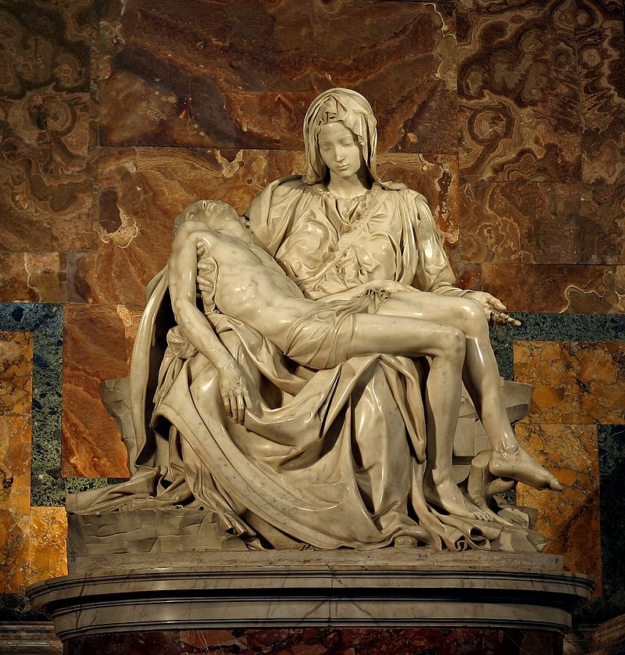
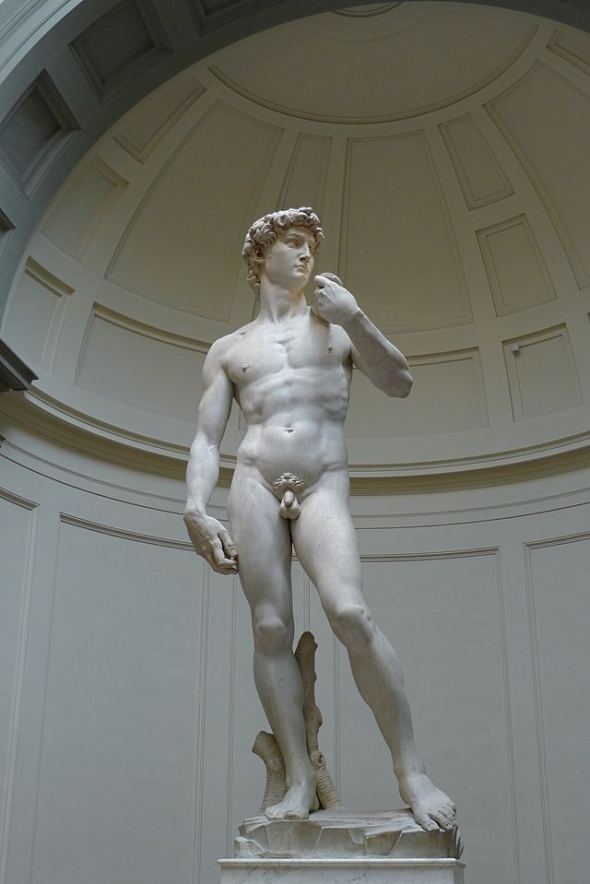
Greatest Work
Two of his best-known works, the Pietà and David, were sculpted before he turned thirty. Pieta is a famous work of art that depicts the body of Jesus on the lap of his mother Mary after the Crucifixion.

Slide 5
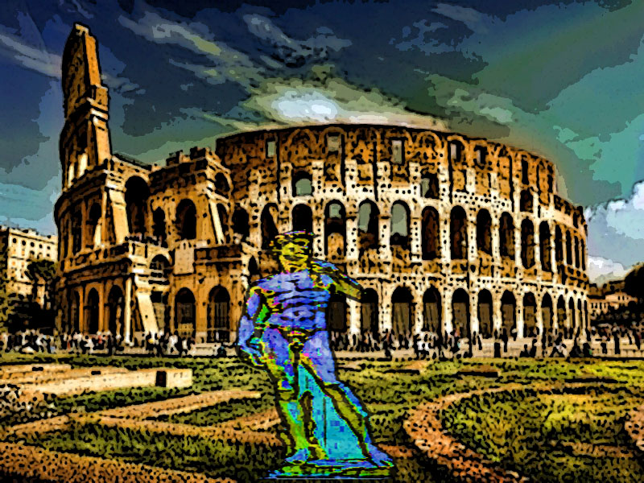
Homage

Slide 6
Reflection
I learned a lot from this power point Michelangelo could very well be the greatest artist to ever live despite all of his problems outside of the painting. Nonetheless I've learned a lot about the art world and Michelangelo in general .

