Slide 1
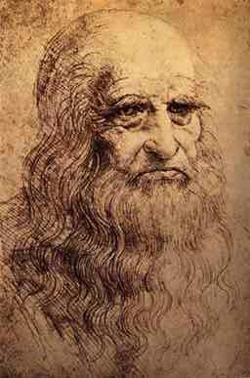
Leonardo da Vinci
Leonardo di ser Piero da Vinci 15 April 1452 – 2 May 1519) was an Italian polymath, painter, sculptor, architect, musician, mathematician, engineer, inventor, anatomist, geologist, cartographer, botanist, and writer. He is widely considered to be one of the greatest painters of all time and perhaps the most diversely talented person ever to have lived.[1] His genius, perhaps more than that of any other figure, epitomized the Renaissance humanist ideal. Leonardo has often been described as the archetype of the Renaissance Man.

Slide 2
Mona Lisa
The Mona Lisa is a half-length portrait of a woman by Leonardo da Vinci, which has been acclaimed as "the best known, the most visited, the most written about, the most sung about, the most parodied work of art in the world". Vasari's account of the Mona Lisa comes from his biography of Leonardo published in 1550, 31 years after the artist's death, and which has long been the best known source of information on the provenance of the work and identity of the sitter. The name of the women was Lisa del Giocondo.

Slide 3
Vitruvian Man
Vitruvian Man is an illustration depicting the perfect balance of our universal nature as portrayed through the scientific proportions of the human figure, made famous by Leonardo’s da Vinci’s classic drawing circa 1490. Vitruvian Man is more of an ideal than an actuality: even da Vinci had to stretch a bit of the anatomical truth in order to render the dimensions of man’s universal perfection.

Slide 4
Last Supper
The Last Supper is the final meal that, in the Gospel accounts, Jesus shared with his Apostles in Jerusalem before his crucifixion. The Last Supper is commemorated by Christians especially on Maundy Thursday. Moreover, the Last Supper provides the scriptural basis for the Eucharist also known as "Holy Communion" or "The Lord's Supper". The term "Last Supper" does not appear in the New Testament. Jesus predicted that one of his Apostles would betray him. It is one of the world's most famous paintings, and one of the most studied, scrutinized, and satirized. The 15th-century mural painting by Leonardo da Vinci in the refectory of the Convent of Santa Maria delle Grazie, Milan.

Slide 5
The Virgin and Child with St. Anne
The Virgin and Child with Saint Anne is an oil painting by Leonardo da Vinci depicting St Anne, her daughter the Virgin Mary and the infant Jesus. Christ is shown grappling with a sacrificial lamb symbolizing his Passion as the Virgin tries to restrain him. In 2008, a curator at the Louvre discovered several faint sketches believed to have been made by Leonardo on the back of the painting. Leonardo's painting is at once both pleasing, calm yet confusing upon closer examination. The composition of the three figures is fairly tight, with the Virgin Mary clearly interacting actively with the infant Jesus.

Slide 6
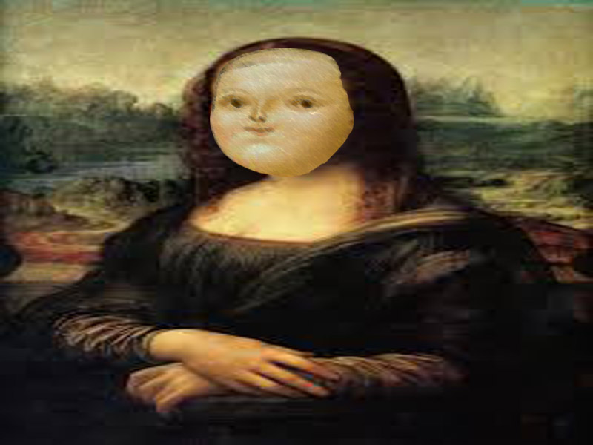
Homage

Slide 7
Reflection
I strongly believe that Leonardo da Vinci is one of the great minds to have ever lived. Every single piece of art he has made is basically priceless because of the complexity of the artworks. He is most likely the inspiration to a lot of young artist or even accomplished artists. There will never be another Leonard no matter how far or hard you look. His catalogue is amazing such artworks such as the Mona Lisa or the Last Supper which have had such a lasting impact in the art community and the world in general.

