Slide 1
Brooklyn Museum by Alexandro Velazquez, Ethan Williams, Nick Esquivias
200 Eastern Pkwy, New York, NY 11238
(718) 638-5000

Slide 2
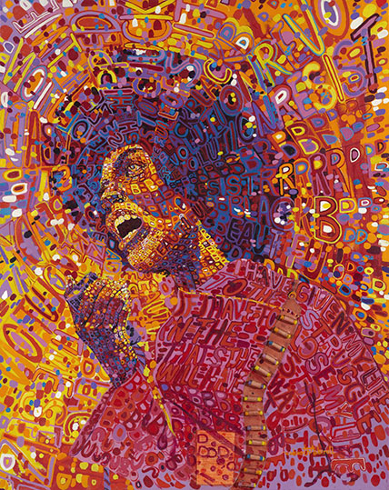
Black Power
This image represents how during the late sixties and seventies, the Black Arts Movement sprung up in the U.S. as the cultural expression of Black Power politics.

Slide 3
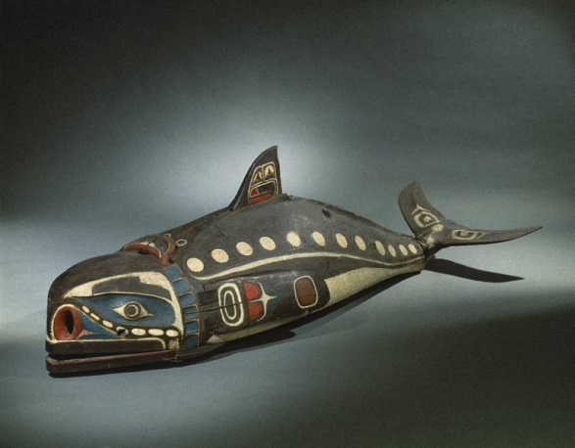
Baleen Whale Mask
This mask is worn along the dancer’s back while he imitates the swimming and diving of the whale by manipulating cords to move the flippers, tail, and jaw.

Slide 4
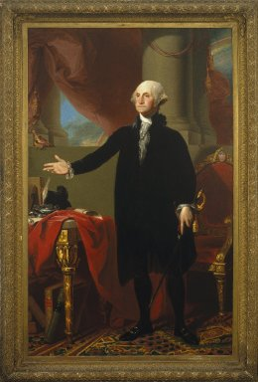
George Washington
Washington appears in formal civilian clothing, but holds a sword that recalls his military achievements and suggests the might of his presidency.

Slide 5
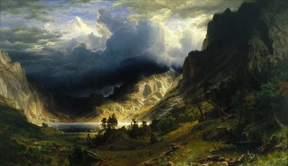
Rocky Mountains, Mt. Rosalie
Albert Bierstadt For the final canvas, he exercised artistic license—rearranging some landmarks and exaggerating the scale of others—to maximize the visual interest of this Rocky Mountain landscape.

Slide 6
Reflection
Our museum reflects very complex art and shows many variations of artistic images of the past and present of American history. This museum is suppose to be one of the largest in the world. This museum has over 1.5 million art works. It also contains some of the most expensive collection of Egyptian and African art. The museum has art objects and historical texts produced by Muslim artist or about Muslim figures and cultures. They have an apprentice program which hires teens. Its contains painting’s of the great painter Lorenzo Di Niccolo. This museum is extended back to 1823 and to this day is still plays a major part in the world of art.

